Slide 1
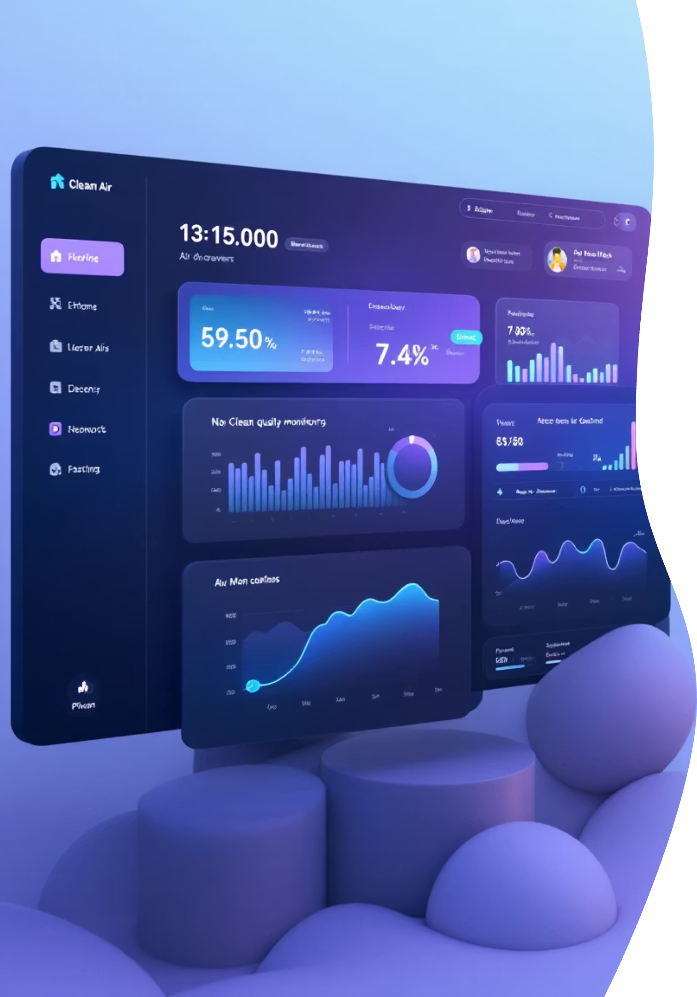
Milestone 1: 35% Project Completion
Air Quality Monitoring System — Building a smarter way to track and visualize air quality data in real-time
INFOSYS SPRINGBOARD
SHARMIKA GANGADHARAN

Slide 2


35% COMPLETE
Foundation Milestone Overview
At 35% completion, we've successfully established the core foundation of the Air Quality Monitoring System. This critical milestone focused on strategic planning, intuitive UI design, and robust frontend architecture—creating a solid launchpad for advanced development phases.
01
02
Planning & Ideation
UI/UX Design
Project scope and objectives defined
Wireframes and dashboard layouts created
03
Frontend Development
Core structure and navigation built

Slide 3


Project Ideation & Scope Finalization
The first step in building any successful application is crystal-clear planning. We finalized the project concept, defined precise objectives, and mapped out the complete scope to prevent future scope creep.
Key Accomplishments
Identified core features for AQI monitoring and data visualization
Established user flow from login to dashboard interaction
Planned modular architecture for scalability
Created feature priority matrix for phased development
This foundational planning phase ensured alignment across all project stakeholders and created a roadmap that guides every development decision.

Slide 4
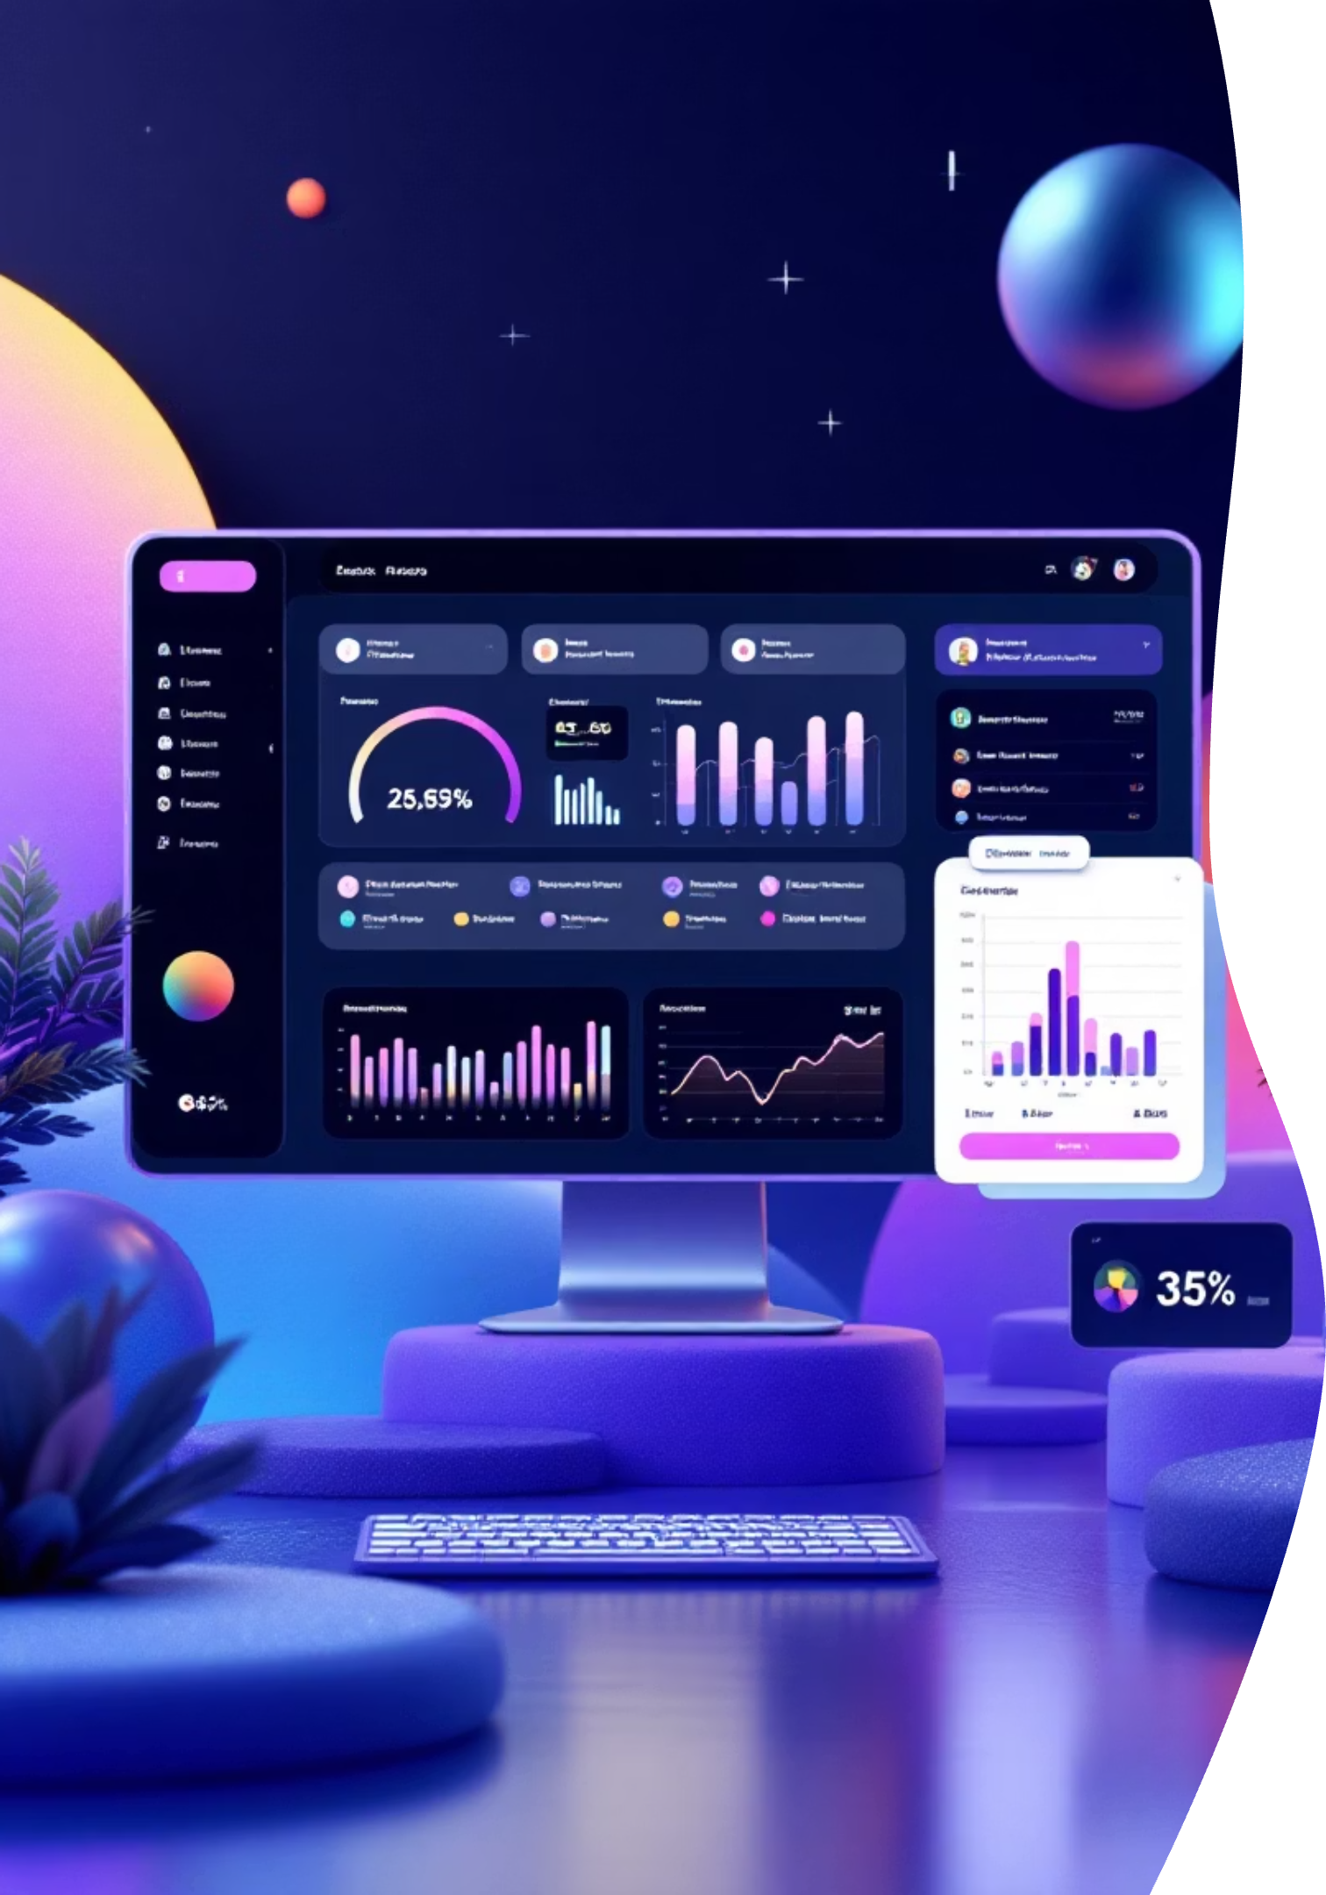
UI Wireframes & Dashboard Design
Great design starts with thoughtful wireframing. We created comprehensive UI wireframes for every major screen, focusing on intuitive navigation and visual hierarchy that puts critical air quality data front and center.
Dashboard Layout
User-Centric Design
Clean, organized interface with AQI metrics prominently displayed for instant insights
Intuitive navigation patterns ensuring users can access any feature within two clicks
Visual Hierarchy
Strategic use of typography and spacing to guide user attention to critical information
These wireframes served as our blueprint, allowing stakeholders to visualize the final product and provide feedback before a single line of code was written.

Slide 5

Authentication Pages Development
Secure User Access
We developed comprehensive authentication pages that balance security with user experience. Both login and registration flows feature clean forms with intelligent validation.
Login Page Features
Streamlined credential entry with email validation
Password visibility toggle for better UX
Remember me functionality
Registration Flow
Input Validation
Error Handling
Multi-field form with real-time validation ensuring data integrity from the start
Client-side checks for email format, password strength, and required fields
Clear, helpful error messages guiding users to successful account creation

Slide 6




Frontend Structure & Navigation
We built a robust frontend architecture using core web technologies, creating a responsive foundation that adapts seamlessly across devices and screen sizes.
HTML Structure
Semantic markup providing accessibility and SEO benefits while maintaining clean, maintainable code
CSS Styling
Custom stylesheets with responsive design principles ensuring consistent appearance across all viewports
JavaScript Functionality
Dynamic interactions and client-side logic powering smooth user experiences and real-time updates
Sidebar Navigation
Persistent menu for quick access to all major sections
Page Routing
Seamless transitions between dashboard components
Responsive Layout
Mobile-first design adapting to any screen size

Slide 7


AQI Parameters & Feature Flow
We identified the essential Air Quality Index parameters that will drive our monitoring system and defined how data flows from collection to visualization.
Core AQI Metrics
PM2.5 and PM10 particulate matter levels
Carbon monoxide (CO) concentrations
Nitrogen dioxide (NO₂) and ozone (O₃) measurements
Overall AQI score with health recommendations
Dashboard Visualization
Processing Engine
Frontend components ready to display live metrics with color-coded health indicators
Data Input Layer
Backend logic planned for real-time data validation and AQI calculation
API endpoints prepared for sensor data ingestion and external AQI sources
This comprehensive feature flow architecture positions us perfectly for seamless backend integration in the next milestone.

Slide 8

Milestone 1: Mission Accomplished
35%
100%
5
Project Complete
UI Design Done
Core Screens
Strong foundation established
All wireframes finalized
Authentication and dashboard
Looking Ahead
With our frontend structure complete and feature flows defined, we're ready to advance into backend integration and real-time AQI data connectivity. The groundwork laid in this milestone ensures a smooth development path forward.
Next: Backend Integration
Real-Time Data Streams
API Development

